Slide 1
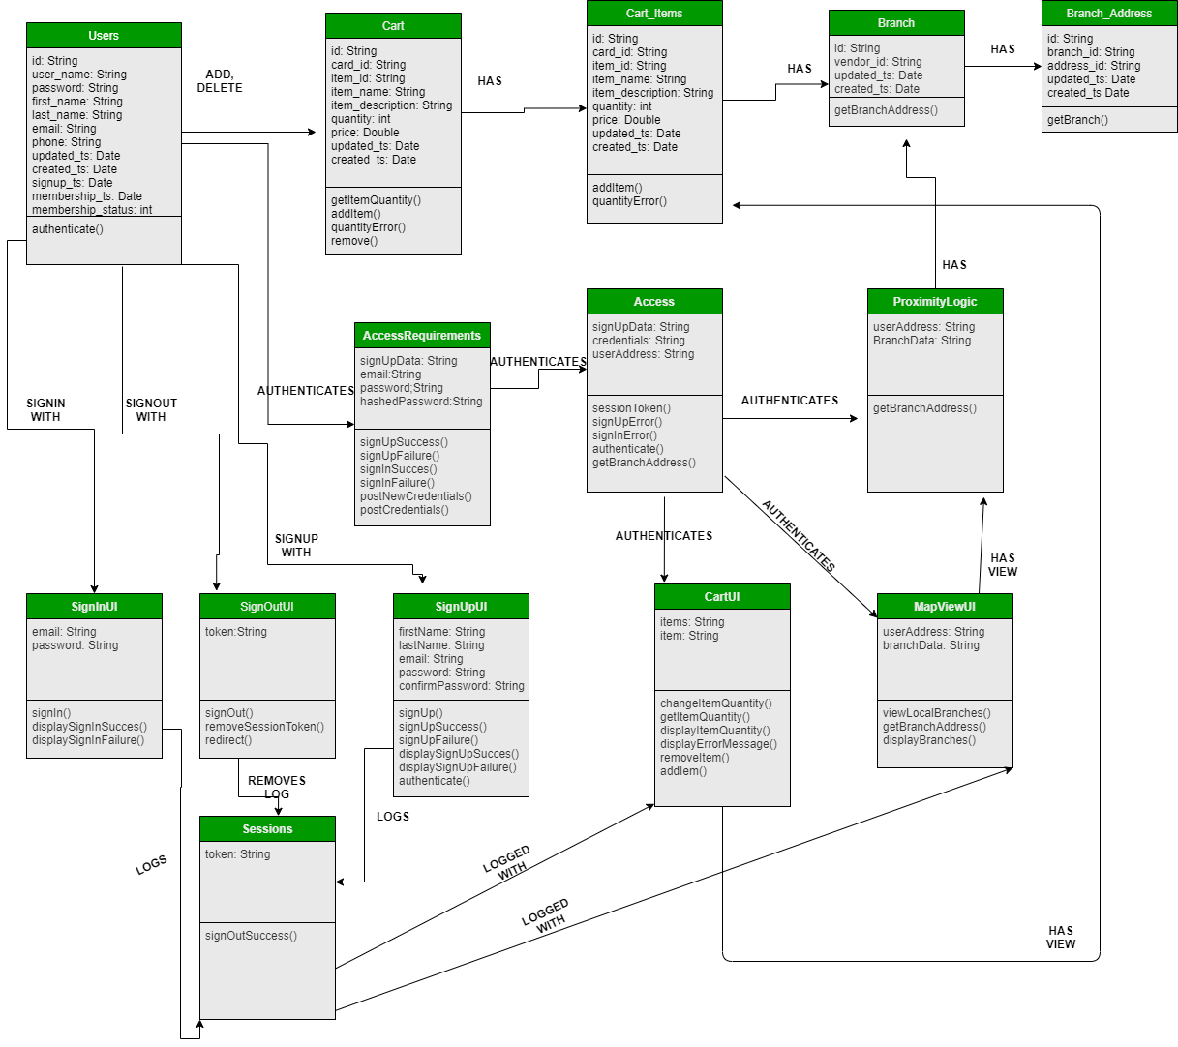
Class Diagram: Carriage

